Slide 1

AGILE DEVELOPMENT METHODS AND ARTEFACTS
By – Kanaga Manikandan Solaikannan

Slide 2
What are agile methods?
Agile Methods are utilised by a team to work effectively and produce the best product.
Talking about Agile Methods used.
SCRUM Meetings
Product Backlog
Burndown Chart

Slide 3
What are scrum meetings?
They take place daily to discuss the progress of the project.
The team members share their stories.
Scrum Meetings are conducted by the Scrum Master of the team.
(MountainGoatSoftware, n.d.)

Slide 4


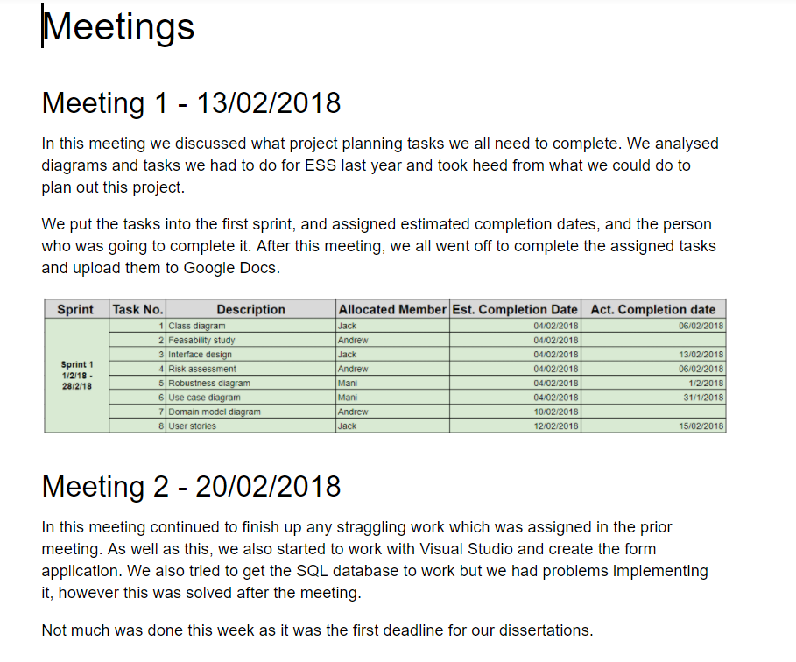
How were scrum meetings helpful?
Commitment between team members.
Conducted by team members themselves.
Helped the team to proceed effectively.
Notes:
1st Point – The team members commit to themselves

Slide 5
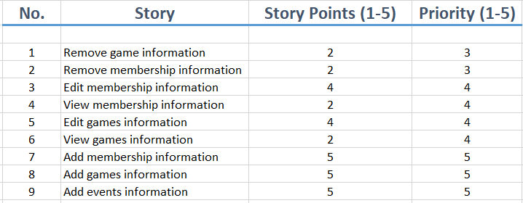
What is a product backlog?
Product Backlog is the list of things that needs to be done within the project.
The product backlog is owned by the Product Owner.
The product backlog is a living document.
(Scrum-Instiute, n.d.)
Notes:
3rd Point – New items may be added to the product backlog and existing items may be modified or even removed.

Slide 6
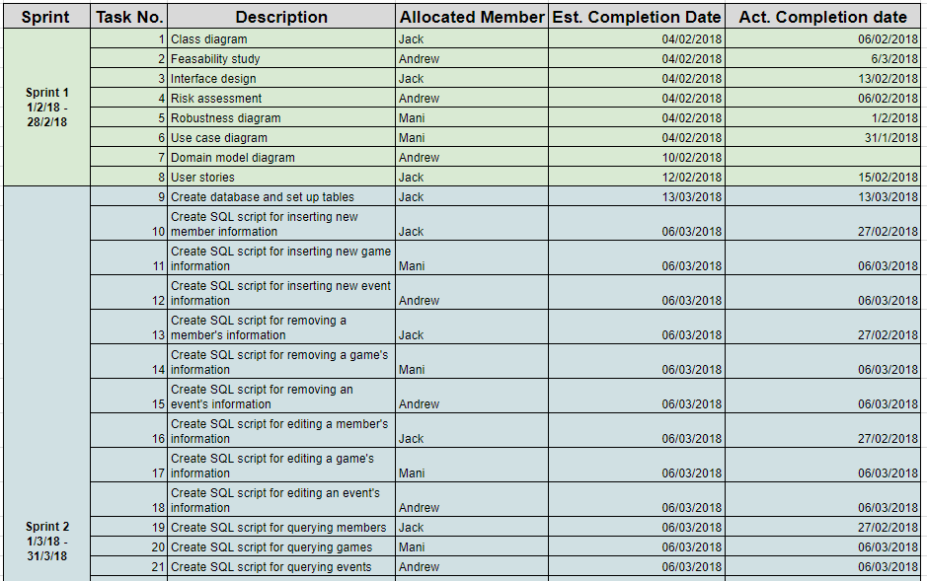
How was a product backlog helpful?
Product Backlog provided a knowledge on the scope and weight of the project.
Items in the Product Backlog became tasks.
Sprints allowed the team members to finish a bulk of work within 2-30 days.
Notes:
New Point – The chosen items in the product backlog become the release backlog.

Slide 7
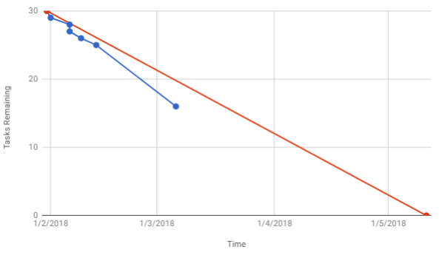
What is a burndown chart?
A visual representation of the amount of work completed against time remaining.
Red line representing the estimated rate of completion.
Team is behind schedule if blue line is above red line.
(AgileNutShell, n.d.)
Notes:
2nd Point – Start point is the point at which no task is completed. End point is 0 meaning no tasks left
3rd Point – Mention the vice-versa
Mention the lines by colour

Slide 8
How was a burndown chart helpful?
A clear idea on the state of progress.
Adapt to the current situation and manage their time more efficiently.
Future of development was easily predicted.
Notes:
3rd Point – Chart shows how many tasks are left, how many done allowing the team to predict the quality of the product

Slide 9
references
MOUNTAIN GOAT SOFTWARE, n.d. The Daily Scrum Meeting [viewed 11 April 2018]. Available from: https://www.mountaingoatsoftware.com/agile/scrum/meetings/daily-scrum
SCRUM-INSTITUTE, n.d. The Scrum Product Backlog – International Scrum Institute [viewed 11 April 2018]. Available from: https://www.scrum-institute.org/The_Scrum_Product_Backlog.php#
AGILE NUTSHELL, n.d. Burndown Charts [viewed 11 April 2018]. Available from: http://www.agilenutshell.com/burndown

